Slide 1
Ethics in Information Technology, Fourth Edition
Chapter 2
Ethics for IT Workers and IT Users

Slide 2
Objectives
As you read this chapter, consider the following questions:
  What key characteristics distinguish a professional from other kinds of workers, and is an IT worker considered a professional?
  What factors are transforming the professional services industry?
  What relationships must an IT worker manage, and what key ethical issues can arise in each?
Ethics in Information Technology, Fourth Edition

Slide 3
Objectives (cont’d.)
  How do codes of ethics, professional organizations, certification, and licensing affect the ethical behavior of IT professionals?
  What is meant by compliance, and how does it help promote the right behaviors and discourage undesirable ones?
Ethics in Information Technology, Fourth Edition

Slide 4
IT Professionals
Profession is a calling that requires:
  Specialized knowledge
  Long and intensive academic preparation
Professionals:
  Require advanced training and experience
  Must exercise discretion and judgment in their work
  Their work cannot be standardized
  Contribute to society, participate in lifelong training, assist other professionals
  Carry special rights and responsibilities(example for performing surgery or prescribe drugs
Ethics in Information Technology, Fourth Edition

Slide 5
Some famous IT professionals
http://freefeast.info/personality-motivation/famous_it_personalities/famous-it-personalities/
Ethics in Information Technology, Fourth Edition

Slide 6
Are IT Workers Professionals?
Partial list of IT specialists
  Programmers
  Systems analysts
  Software engineers
  Database administrators
  Local area network (LAN) administrators
  Chief information officers (CIOs)
Ethics in Information Technology, Fourth Edition

Slide 7
The Changing Professional Services Industry
IT workers are considered part of the professional services industry
Seven forces are changing professional services
  Client sophistication (able to drive hard bargains)
  More aware of what they need from service providers.
  More willing to look outside their own organization to get the best possible services at lowest possible cost.
  Governance (due to major scandals)
  To avoid future scandals
  For example, now a days it is commonly accepted that IT service organization that process the data of their customers must show that they have adequate controls and safeguards in place.
  Connectivity (instant communications)
  Clients have built their working relationship on the expectation that they can communicate easily and instantly around the globe through video conferences and teleconferences, email , text messaging etc.

Slide 8
  Transparency (view work-in-progress in real-time)
  Involves an attempt to reveal and clarify any information or processes
  That were previously hidden or unclear.
  Modularization (able to outsource modules)
  Dividing the tasking into subparts and decides which function clients will perform which other person will perform.
  Globalization (worldwide sourcing)
  Process of interaction among the people, companies and government of different nations.
  Networks are extended globally
  Commoditization (for low-end services)
Ethics in Information Technology, Fourth Edition

Slide 9
Commoditized products have thin margins and are sold on the basis of price and not brand. This situation is characterized by standardized, ever cheaper, and common technology that invites more suppliers who lower the prices even further.
Companies usually cannot raise prices because consumers can shop at competitors offering the same or similar products at lower prices
Example:-
Technology
The technology industry is known for its innovation, but it is also home to commoditized products. For example, memory chips, hard-disk drives, monitors, flash drives, power supplies, keyboards and other desktop and laptop components are commoditized products because price is the only distinguishing factor between different vendors. In certain price ranges, cell phones, televisions and microwaves are also commodity products. However, the central processing unit and graphics chips that power computers and electronic devices are not commoditized products because of significant differences in features, such as processing speed, functionality and power efficiency
Ethics in Information Technology, Fourth Edition

Slide 10
Professional Relationships That Must Be Managed
IT workers involved in relationships with:
  Employers
  Clients
  Suppliers
  Other professionals
  IT users
  Society at large
Ethics in Information Technology, Fourth Edition

Slide 11

clients
Employers
suppliers
IT WORKERS
Society
Others
professionals
IT users
Ethics in Information Technology, Fourth Edition

Slide 12
Relationships Between
IT Workers and Employers
IT workers agree on many aspects of work relationship before workers accept job offer
(certain issues include:- job title, general performance expectations, dress code, location of employee, salary,work hours and company benefits)
Other aspects of work relationship defined in company’s policy and procedure manual or code of conduct(companies secrets, vacation policy, use of company resources)
Some aspects develop over time(whether employee can leave early one day if the time is made up another day)
IT workers must set an example and enforce policies regarding the ethical use of IT in:
Ethics in Information Technology, Fourth Edition

Slide 13
Relationships Between
IT Workers and Employers
  Software piracy
  Act of illegally making copies of software or enabling access to software to which they are not entitled
  Area in which IT workers can be tempted to violate laws and policies
  The Business Software Alliance (BSA) is a trade group representing the world’s largest software and hardware manufacturers; mission is to stop the unauthorized copying of software
  Thousands of cases prosecuted each year
Ethics in Information Technology, Fourth Edition

Slide 14
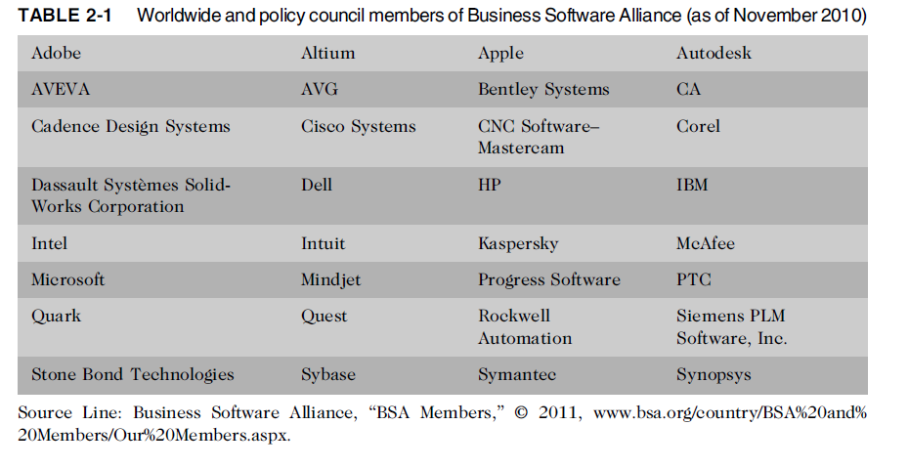
Relationships Between
IT Workers and Employers (cont’d.)
Ethics in Information Technology, Fourth Edition

Slide 15
IT workers must set an example and enforce policies regarding the ethical use of IT in: (cont’d.)
  Trade secrets
    Business information generally unknown to public
    Company takes actions to keep confidential
    Require cost or effort to develop
    Have some degree of uniqueness or novelty
    It can include design of new software code, manufacturing processes etc.
    Example
    The Colonel’s secret reciepe of 11 herbs and spices used to make the original KFC chicken.
    The formula for Coke
    Intel manufacturing process for i7 quad core processor.
    Employers worry that employees will reveals such secrets, if they leave the company. As a result companies require employees to sign confidentiality agreement
Ethics in Information Technology, Fourth Edition

Slide 16
Example of trade secrets
http://info.vethanlaw.com/blog/trade-secrets-10-of-the-most-famous-examples
Ethics in Information Technology, Fourth Edition

Slide 17
Whistle blowing
- an effort by an employee to attract attention to illegal or unethical act by a company that threatens the public interest.
Whistle blowers often have special info based on their expertise or position.
examples :-
https://www.quora.com/Who-are-some-of-the-famous-whistleblowers-in-India
Ethics in Information Technology, Fourth Edition

Slide 18
Relationships Between
IT Workers and Clients
IT worker provides:
  Hardware, software, or services at a certain cost and within a given time frame
Client provides:
  Compensation
  Access to key contacts
  Work space
Relationship is usually documented in contractual terms
Ethics in Information Technology, Fourth Edition

Slide 19
Relationships Between
IT Workers and Clients (cont’d.)
Client makes decisions about a project based on information, alternatives, and recommendations provided by the IT worker
Client trusts IT worker to act in client’s best interests
IT worker trusts that client will provide relevant information, listen to and understand what the IT worker says, ask questions to understand impact of key decisions, and use the information to make wise choices
Ethics in Information Technology, Fourth Edition

Slide 20
Relationships Between
IT Workers and Clients (cont’d.)
Problems arise during a project if IT workers are unable to provide full and accurate reporting of a project’s status
  Finger pointing and heated discussions can ensue
Ethics in Information Technology, Fourth Edition

Slide 21
Relationships Between
IT Workers and Clients (cont’d.)
Ram Sumiran Pal, Speak Asia
Fraud
wrongful or criminal deception intended to result in financial or personal gain
  Crime of obtaining goods, services, or property through deception or trickery
  Example:-
  Ram Sumiran Pal, Speak Asia
  Speak Asia was an online trading company founded by Ram Sumiran Pal and his brother. Pal and his associates duped at least 24 lakh investors for Rs 2,200 crore in the scam extending to Singapore, Italy, and Brazil, among others.
Ethics in Information Technology, Fourth Edition
Speak Asia was an online trading company founded by Ram Sumiran Pal and his brother. Pal and his associates duped at least 24 lakh investors for Rs 2,200 crore in the scam extending to Singapore, Italy, and Brazil, among others.

Slide 22
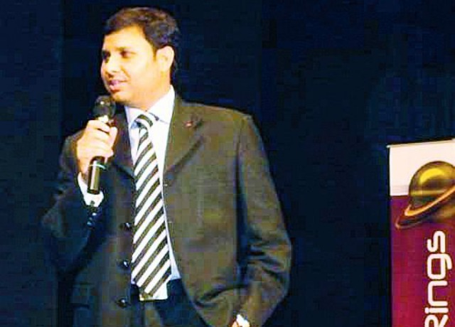
Ethics in Information Technology, Fourth Edition

Slide 23

Business tycoon Vijay Mallya is in the news for failing to repay the nearly Rs. 7,000 crores to various banks and his subsequent fleeing from India.
Ethics in Information Technology, Fourth Edition

Slide 24
Misrepresentation
  Misstatement or incomplete statement of material fact
  If misrepresentation causes a party to enter into a contract, that party may have the right to cancel contract or seek reimbursement for damages
  Misrepresentation is the giving of false information by one party (or her or his agent) to the other before the contract is made, which induces them to make the contract. If you make a contract in reliance on a misrepresentation and suffer loss as a result, you can cancel the contract or claim damages.
Ethics in Information Technology, Fourth Edition

Slide 25
Relationships Between
IT Workers and Clients (cont’d.)
Breach of contract
  One party fails to meet the terms of a contract
  can occur if any of the agreed terms and conditions of a contract are broken, and the consequences can lead to legal action.
IT projects are joint efforts in which vendors and customers work together
  When there are problems, it is difficult to assign who is at fault
Ethics in Information Technology, Fourth Edition

Slide 26
Example of breach of contract
Nike sues Virat Kohli for breach of contract
Nike had entered into a contract with Virat Kohli from January 1, 2007 to December 31, 2007. Later, a fresh contract was signed for the period between August 1, 2008 and July 31, 2013 for exclusive endorsement rights.
According to The Hindu, Virat Kohli was paid Rs 1.42 crore for this contract that carried a clause for extension for another year, till July 31, 2014 with certain conditions.
While planning to extend the contract and also sign Kohli beyond 2014, Nike was shocked to receive a letter from Kohli on June 6, 2013. The sports giant claims that Kohli "made certain self-serving and baseless allegations with respect to implementation of the contract" and rejected its extension through the letter.
The firm also alleges that Kohli's action was a result of non-acceptance of his unilateral and unreasonable terms suggested by him earlier.
Nike, in its suit, has pleaded with the court to restrain Kohli from entering into or negotiating any endorsement deal with any third party until the expiry of the deal, company counsel Aditya Sondhi said.
Ethics in Information Technology, Fourth Edition

Slide 27
Relationships Between
IT Workers and Suppliers
Develop good working relationships with suppliers:
  By dealing fairly with them
  By not making unreasonable demands
Ethics in Information Technology, Fourth Edition

Slide 28
Relationships Between
IT Workers and Suppliers (cont’d.)
Bribery
  Providing money, property, or favors to obtain a business advantage
  U.S. Foreign Corrupt Practices Act (FCPA): crime to bribe a foreign official, a foreign political party official, or a candidate for foreign political office
  At what point does a gift become a bribe?
  No gift should be hidden
  Perceptions of donor and recipient can differ
  United Nations Convention Against Corruption is a global treaty to fight bribery and corruption
Ethics in Information Technology, Fourth Edition

Slide 29
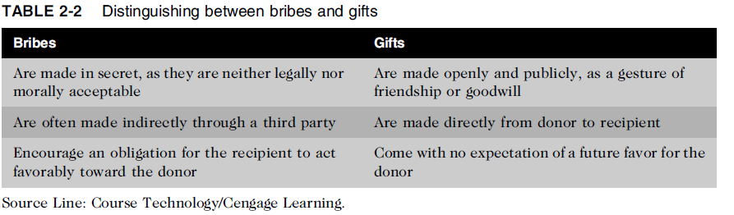
Relationships Between
IT Workers and Suppliers (cont’d.)
Ethics in Information Technology, Fourth Edition

Slide 30
Ethical problems among the IT profession
  Résumé inflation on 30% of U.S. job applications
Resume inflation refers to the act of including false or misleading information on one's resume making oneself a more attractive candidate for a job. Examples include adding degrees or awards one never received or positions one never held.
  Inappropriate sharing of corporate information
    Information might be sold intentionally or shared informally with those who have no need to know
Ethics in Information Technology, Fourth Edition

Slide 31
Relationships Between
IT Workers and IT Users
IT user: person using a hardware or software product
IT workers’ duties
  Understand users’ needs and capabilities
  Deliver products and services that meet those needs
  Establish environment that supports ethical behavior:
    To discourages software piracy
    To minimize inappropriate use of corporate computing resources(wastage of time using unnecessary websites)
    To avoid inappropriate sharing of information
Ethics in Information Technology, Fourth Edition

Slide 32
Relationships Between
IT Workers and Society
Society expects members of a profession:
  To provide significant benefits
  To not cause harm through their actions
Actions of an IT worker can affect society
Professional organizations provide codes of ethics to guide IT workers’ actions
Ethics in Information Technology, Fourth Edition

Slide 33
Professional Codes of Ethics
State the principles and core values that are essential to the work of an occupational group
Most codes of ethics include:
  What the organization aspires to become
  Rules and principles by which members of the organization are expected to abide
Many codes also include commitment to continuing education for those who practice the profession
Ethics in Information Technology, Fourth Edition

Slide 34
Professional Codes of Ethics
(cont’d.)
Following a professional code of ethics can produce benefits for the individual, the profession, and society as a whole
  Ethical decision making
  High standards of practice and ethical behavior(reminds the professionals of their duties that they may be tempted to compromise to meet day to day pressure)
  Trust and respect from general public
  Evaluation benchmark for self-assessment
Ethics in Information Technology, Fourth Edition

Slide 35
Certification
Indicates that a professional possesses a particular set of skills, knowledge, or abilities in the opinion of the certifying organization
Can also apply to products
Generally voluntary
Employers view as benchmark(mastery) of knowledge
Opinions are divided on value of certification
Ethics in Information Technology, Fourth Edition

Slide 36
Certification (cont’d.)
Vendor certifications(CISCO,IBM,SAP)
  Some certifications substantially improve IT workers’ salaries and career prospects
  Relevant for narrowly defined roles or certain aspects of broader roles
  Require passing a written exam, or in some cases, a hands-on lab to demonstrate skills and knowledge
  Can take years to obtain necessary experience
  Training can be expensive
Ethics in Information Technology, Fourth Edition

Slide 37
Certification (cont’d.)
Industry association certifications
  Require a higher level of experience and a broader perspective than vendor certifications
  Must sit for and pass written exam
  May need to pay annual renewal fee, earn continuing education credits, and/or pass renewal test
  Lag in developing tests that cover new technologies
  Are moving from purely technical content to a broader mix of technical, business, and behavioral competencies
Ethics in Information Technology, Fourth Edition

Slide 38
examples
CCNA
Microsoft certified professionals
Microsoft Certified Systems Administrators
CCNP
5. ORACLE
6. SCO(Search engine optimization)
Ethics in Information Technology, Fourth Edition

Slide 39
Government Licensing
License is a government-issued permission to engage in an activity or operate a business
Often requires that recipient pass a test
Some professionals must be licensed – doctors, lawyers, CPAs(Certified Public Accountant (CPA) is a designation given by the American Institute of Certified Public Accountants to those who pass an exam and meet work experience requirements), medical and day care providers, engineers
One goal: protect public safety
Ethics in Information Technology, Fourth Edition

Slide 40
Government Licensing (cont’d.)
Without licensing, there are no requirements for heightened care and no concept of professional malpractice
Ethics in Information Technology, Fourth Edition

Slide 41
Government Licensing (cont’d.)
Issues associated with government licensing of IT workers
    No universally accepted core body of knowledge(no standards for licensing programmers)
    Unclear who should manage content and administration of licensing exams(who will conduct the exam or what if the license expires?)
    No administrative body to accredit professional education programs(no step by step process to train IT workers)
    No administrative body to assess and ensure competence(ability to do something) of individual workers(lawyers or doctors may lose their license for failing to meet those standards)
Ethics in Information Technology, Fourth Edition

Slide 42
IT Professional Malpractice
Negligence: not doing something that a reasonable person would do, or doing something that a reasonable person would not do
Duty of care: obligation to protect people against any unreasonable harm or risk
(example:- people have trained their pets not to attack ) similarly businesses must keep dangerous pollutants out of the air.
  Reasonable person standard(how a person would have acted in the same situation)
  Reasonable professional standard(example of a heart or bone surgery)
  Breach of the duty care:- is the failure to act how a reasonable person would act.
Ethics in Information Technology, Fourth Edition

Slide 43
Example:-
Police officer not protecting a citizen from an attacker
Ethics in Information Technology, Fourth Edition

Slide 44
IT Users
Employees’ ethical use of IT is an area of growing concern because of increased access to:
  Personal computers
  Corporate information systems and data
  The Internet
Ethics in Information Technology, Fourth Edition

Slide 45
Common Ethical Issues for IT Users
Software piracy
Inappropriate use of computing resources
  is possible for all employees, including IT staff. Any person using company resources for unlawful purposes is subject to dismissal and prosecution. What employees must understand is that some activities that are lawful at home are considered grounds for dismissal if conducted at work, because they are against the allowed use policy of the company..
Inappropriate sharing of information, including:
  is an IT problem if the company views sensitive information as an IT asset. It is possible to reveal information over the phone, over the Internet, by fax, by email, in person, or any number of other ways a thief can devise. All should be avoided unless the holder of the information has reason to give it to a requester.

Slide 46
Supporting the Ethical Practices of
IT Users
Policies that protect against abuses:
  general rights and responsibilities of users
  Create boundaries of acceptable behaviour
  Enable management to punish violators
Policy components include:
  Establishing guidelines for use of company software
  Defining appropriate use of IT resources
  Structuring information systems to protect data and information
  Installing and maintaining a corporate firewall
Ethics in Information Technology, Fourth Edition

Slide 47
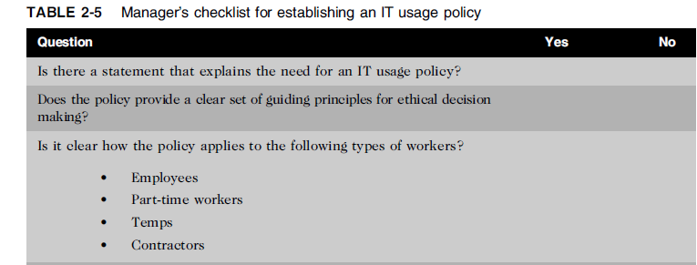
Supporting the Ethical Practices of
IT Users (cont’d.)
Ethics in Information Technology, Fourth Edition

Slide 48
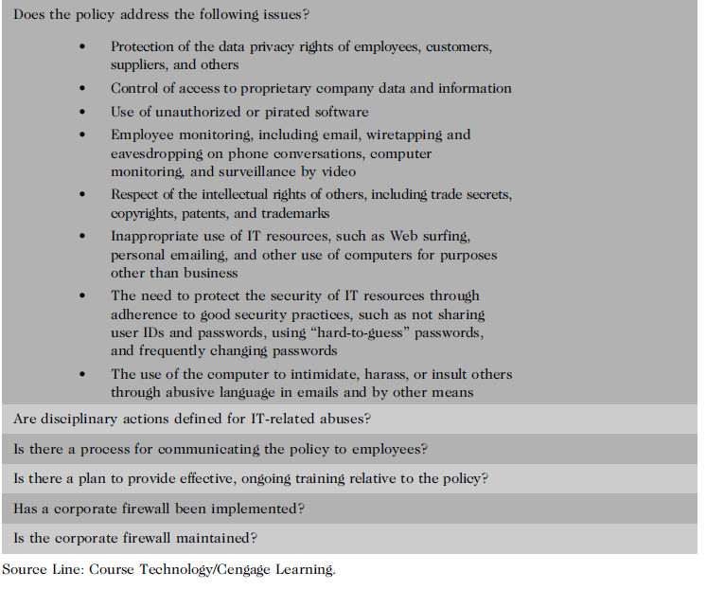
Ethics in Information Technology, Fourth Edition

Slide 49
Compliance
the action or fact of complying with a wish or command.
the act of submitting; usually surrendering power to another
To be in accordance with established policies, guidelines, specifications, and legislation
  Sarbanes-Oxley – established requirements for internal controls(financial records)
  HIPAA(Health Insurance Portability and Accountability Act) – ensures security and privacy of employee healthcare data
  Failure to this can lead to criminal or civil penalties and also lawsuits
Ethics in Information Technology, Fourth Edition

Slide 50
Compliance (cont’d.)
Audit committee is subset of the board of directors, with oversight for the following activities:
  The basic responsibilities include monitoring the reporting process and paying attention to management and employees.
  Performance of company’s internal audit team
Ethics in Information Technology, Fourth Edition

Slide 51
Compliance (cont’d.)
Internal audit committee responsibilities:
  Determine that internal systems and controls are adequate and effective
  Verify existence of company assets and maintain proper safeguards over their protection
  Measure the organization’s compliance with its own policies and procedures
  Insure that institutional policies and procedures, appropriate laws, and good practices are followed
  Evaluate adequacy and reliability of information available for management decision making
Ethics in Information Technology, Fourth Edition

